Slide 2
Commands
init → initializes local git repository (on local system)
add <file>→ Add the files specified to the staging area.
status → check the status of the files present in the staging area.
commit → save your files in git
--------------------------------------------------------------------------------------------------
push → upload git commits to remote repo like GitHub
pull → download changes from the remote repo to your local machine
clone -> bringing a repo from some hosting website (like GitHub) into our local machine.

Slide 3
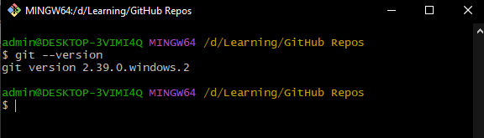
Version Checking

Slide 4
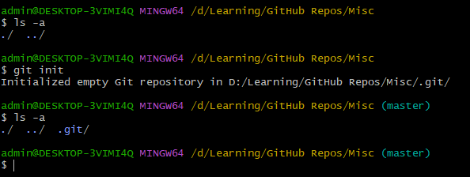

Creating .git folder on local machine
run $\$ git init$ command to create a .git folder inside the current working directory.

Slide 5

Configuring .git folder with credentials

Slide 6
Add files to git

